Slide 1





Database Fundamentals And
Microsoft Access
For Beginners
2 Explore MS Access
Prepared By :
Said Fawzy
Manager of Information Center
Tendering Department
Arab Contractors

Slide 2
Contents
Task 1 : Creating Database from Template.
Task 2 : Be a RDBMS for 10 minutes.
What is Microsoft Access

Slide 3

What is Microsoft Access?

Slide 4
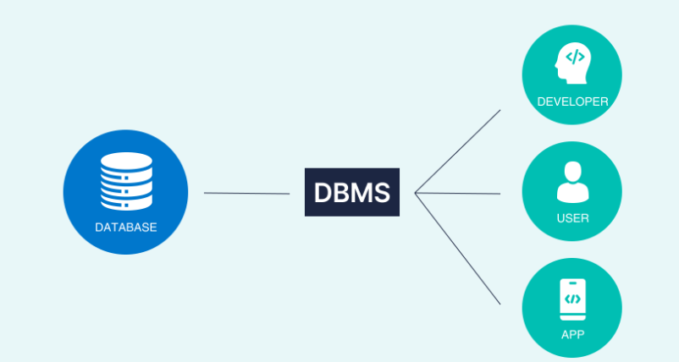

Microsoft Access is a database management system (DBMS) from Microsoft

Slide 5
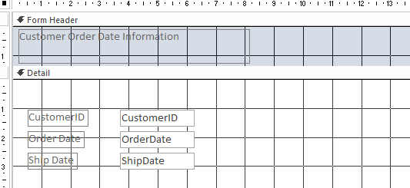
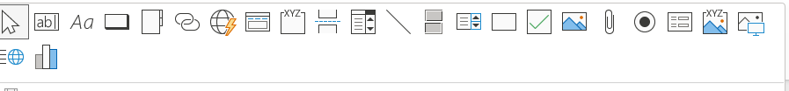
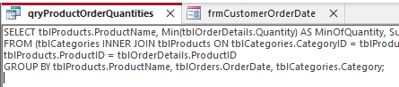
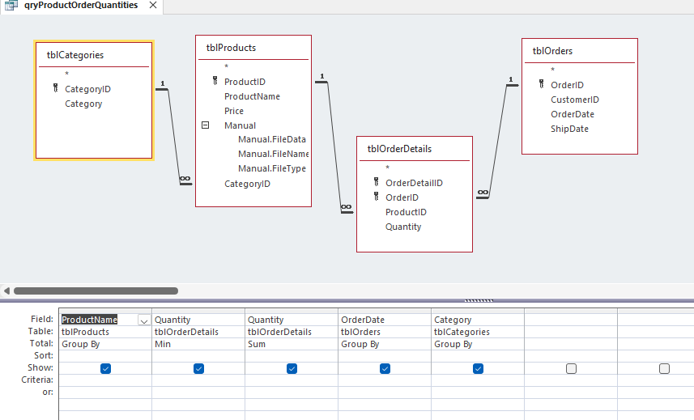
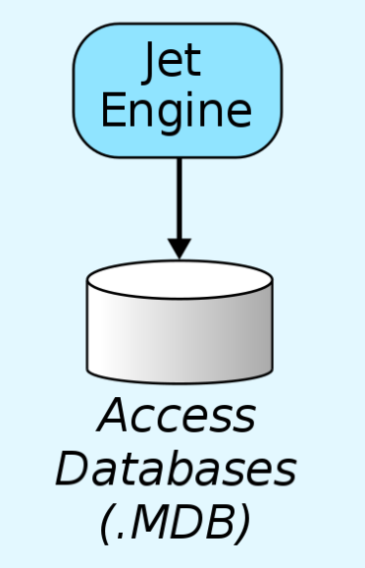
software-development tools
a graphical user interface
Microsoft Access combines :
Relational Access Database Engine (ACE)

Slide 6
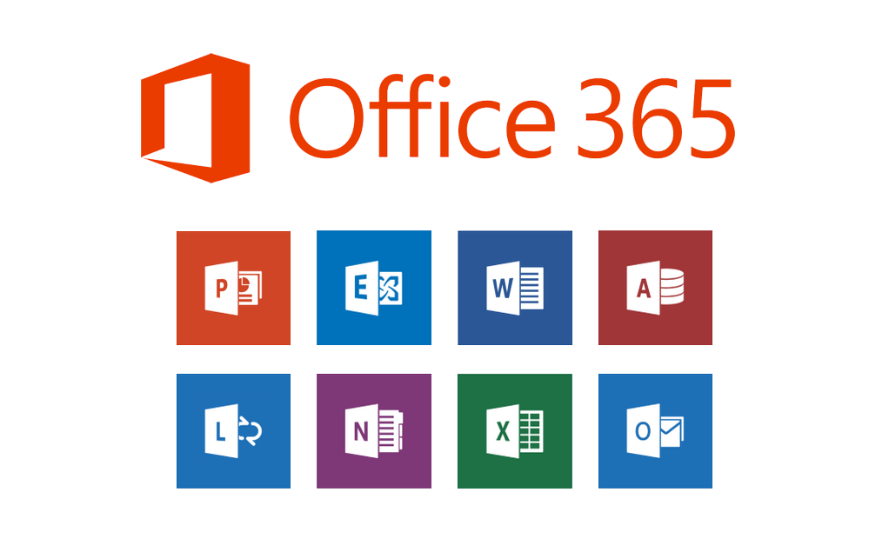
It is a member of the Microsoft 365 suite of applications, included in the Professional and higher editions or sold separately.

Slide 7

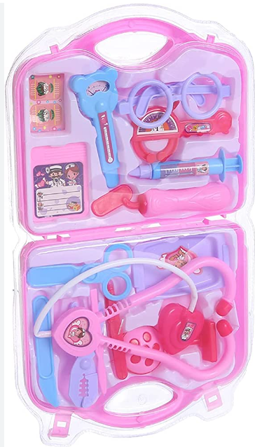


It might look like

Slide 8

But It is still
strong
popular
easy
Database

Slide 9
Access Database Example
Tenders DB
Cost Control Program
Bid Bow Construction Estimating Software (Canada).
Competitors Analysis as a web application in 2001

Slide 10
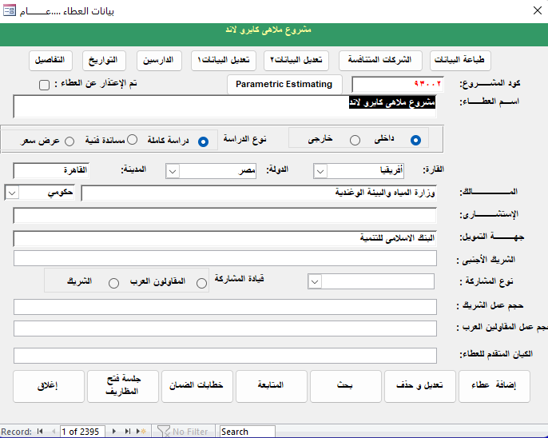
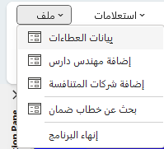

Tenders

Slide 11
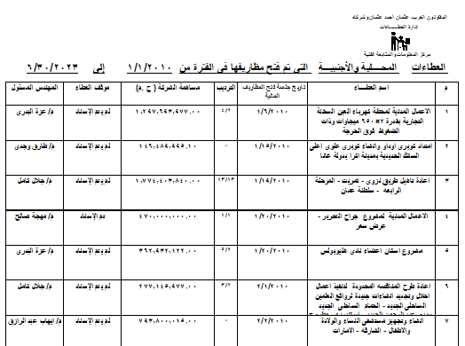
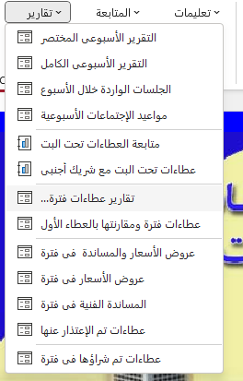
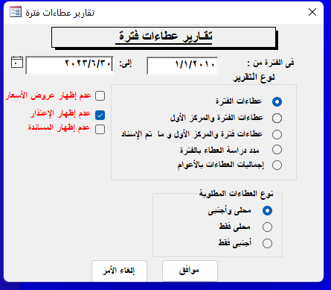
Tenders

Slide 12
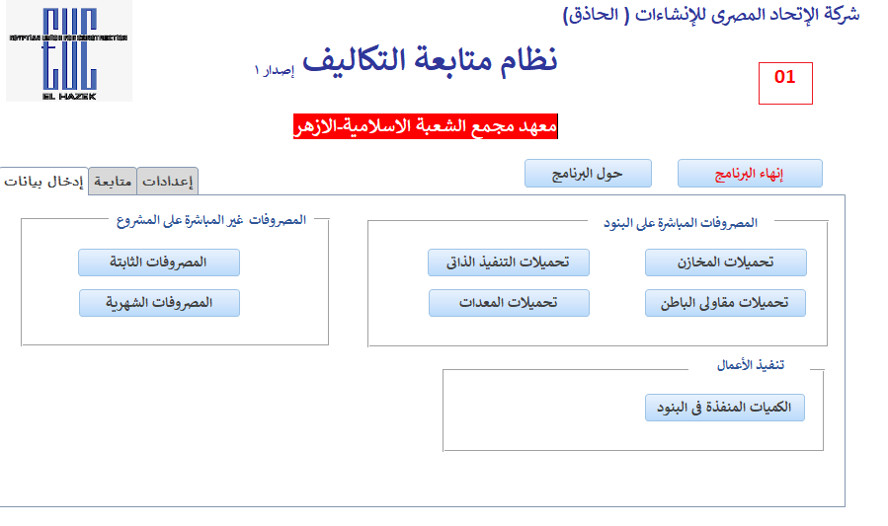
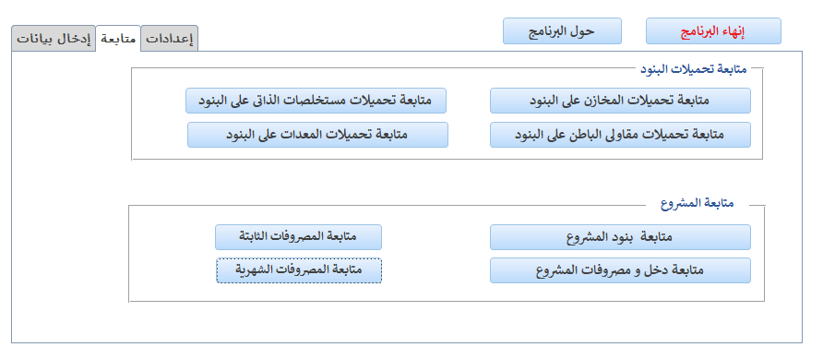
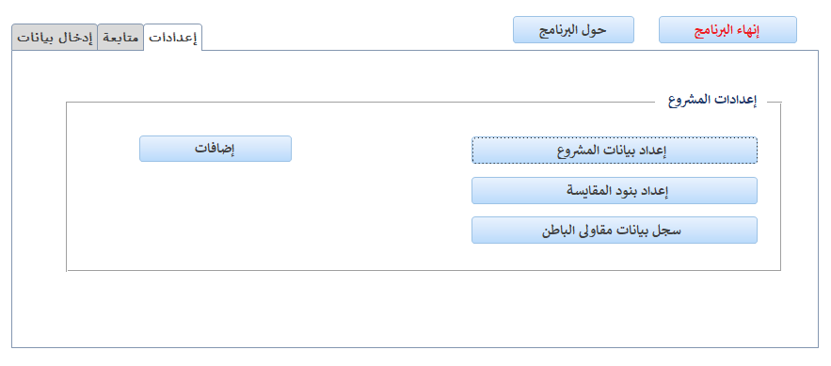
Cost Control

Slide 13
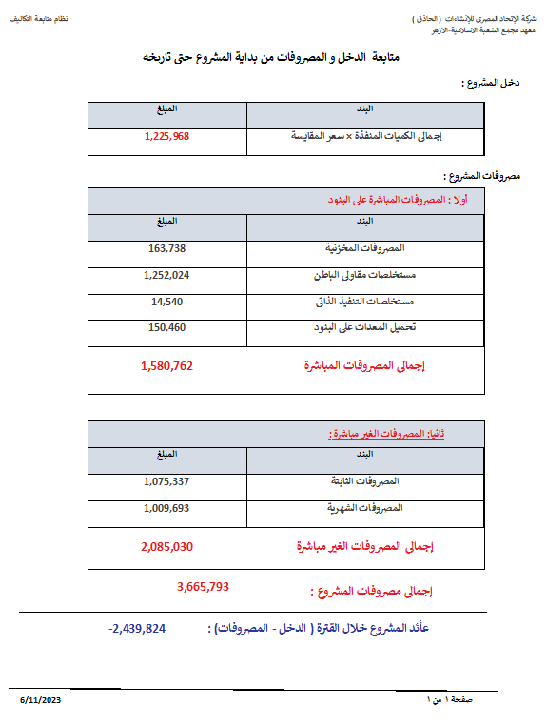
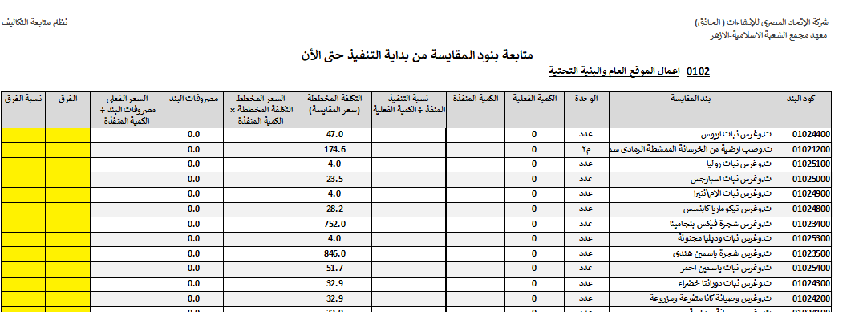
Cost Control

Slide 14
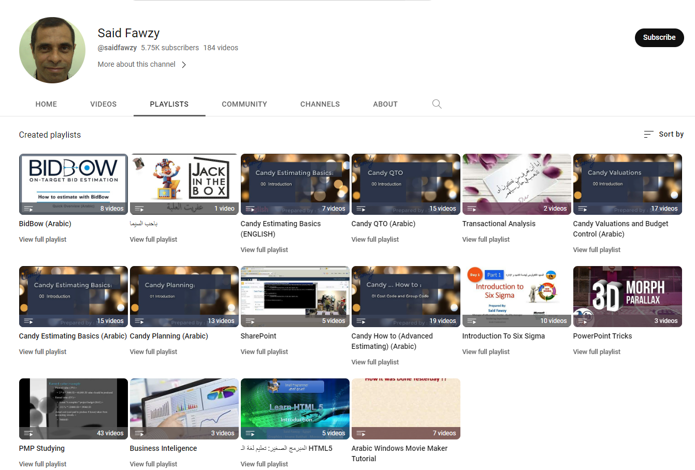
https://www.youtube.com/user/saidfawzy
BidBow

Slide 15
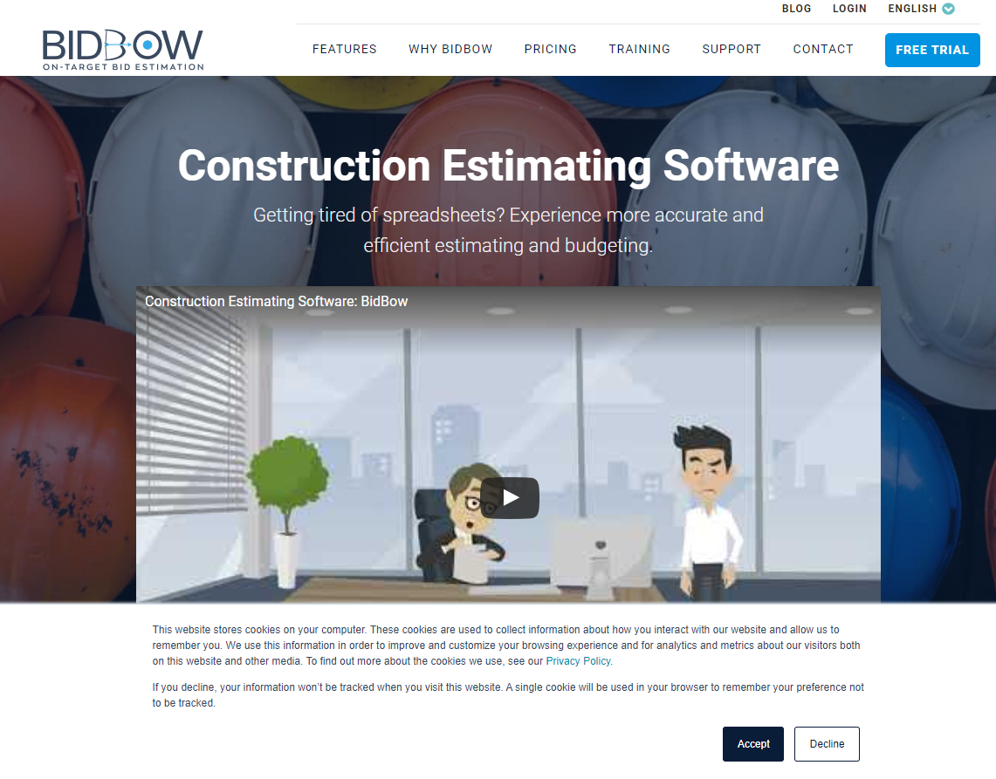
BidBow
https://www.bidbow.com

Slide 16
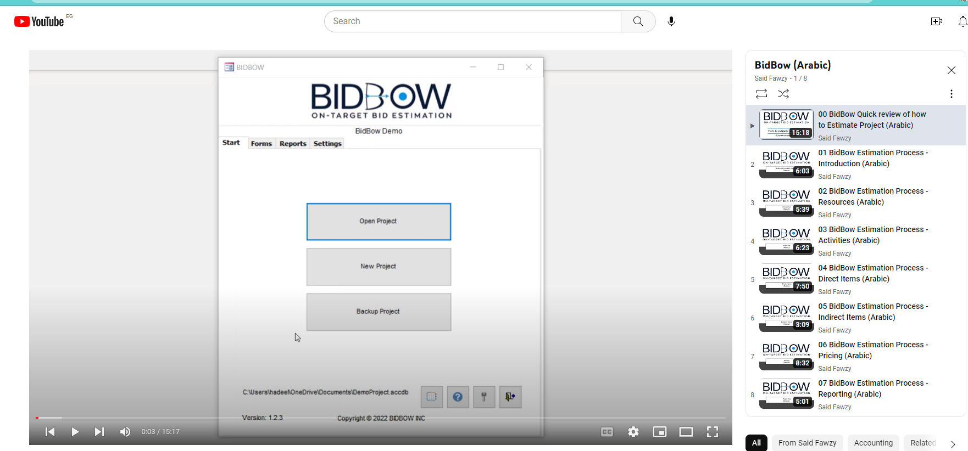

Slide 17
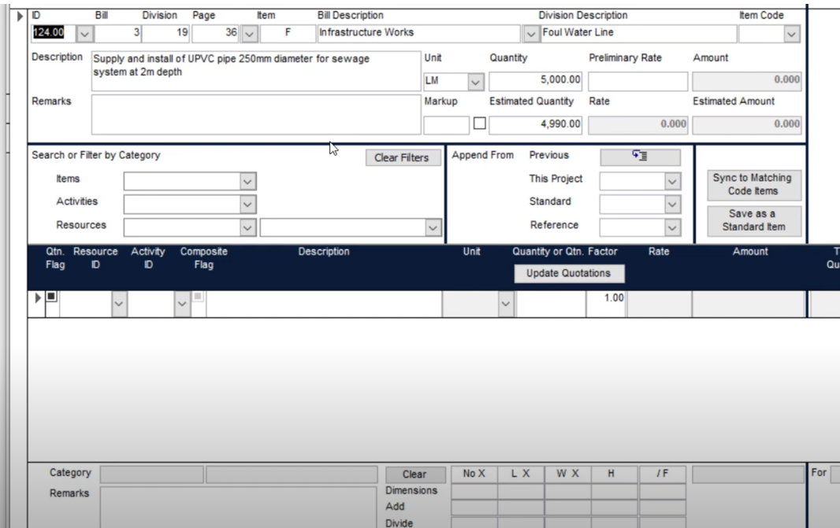

Slide 18
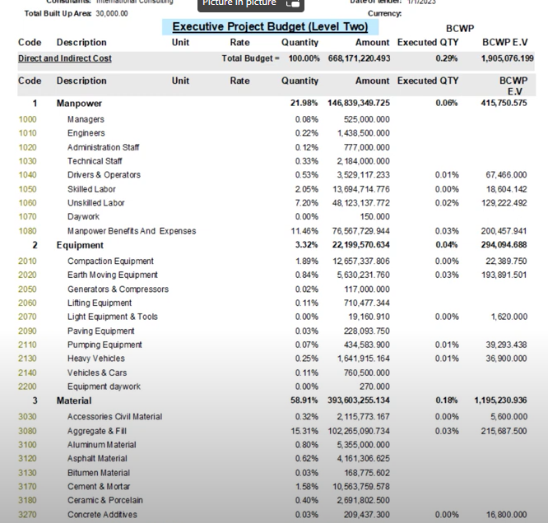

Slide 19
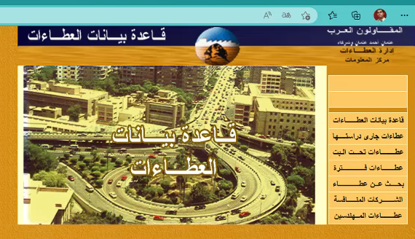
Web Application
Competitors Analysis 2001

Slide 20
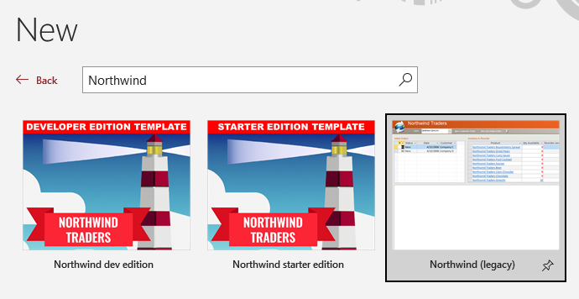
Task 1 : Creating Database from Template

Slide 21

Task 2 : Be A RDBMS for 10 Minutes
Job : We need to record Employees Data

Slide 22

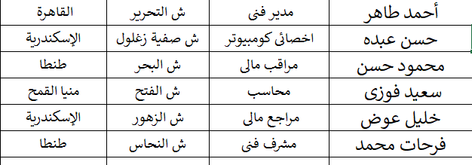
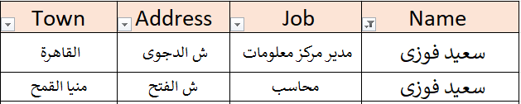
Emp
بيانات سعيد فوزى

Slide 23
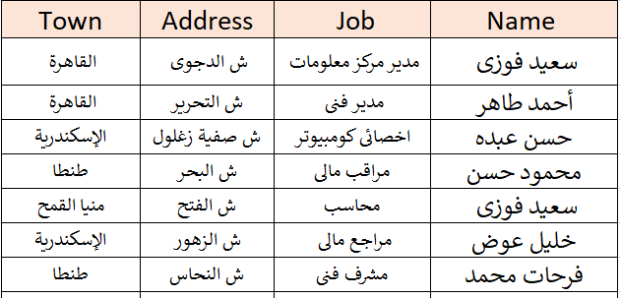
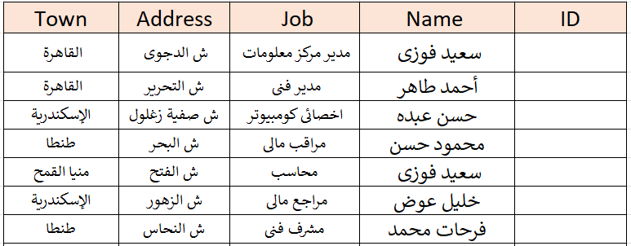
Constraints
Emp
PK
INSERT
Required
UPDATE
Unique

Slide 24
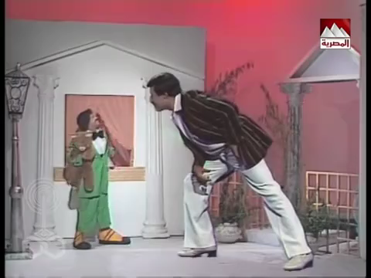
Constraints
Emp
PK
INSERT
Required
UPDATE
Unique

Slide 25
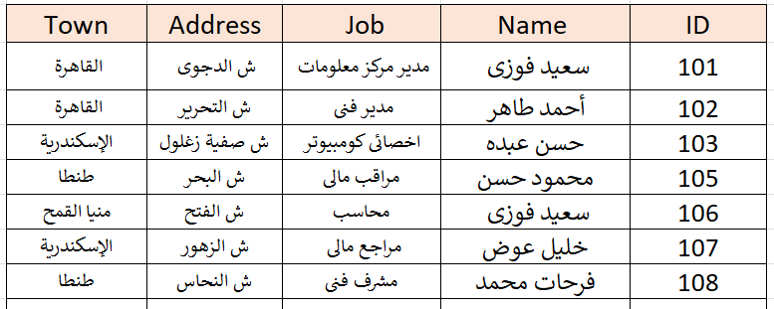
Emp
INSERT

Slide 26

Emp
INSERT

Slide 27
Emp
INSERT

Slide 28
Emp
INSERT

Slide 29
Emp
INSERT

Slide 30


Slide 31
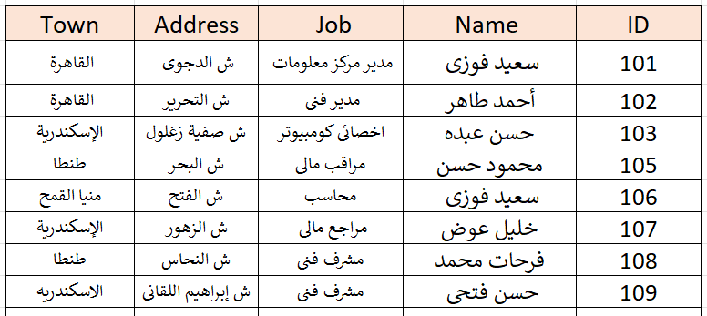


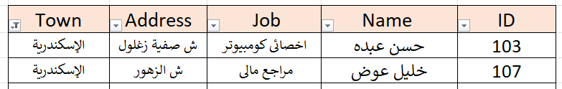
Emp
الإسكندرية

Slide 32
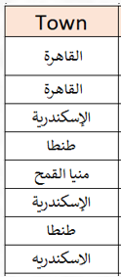
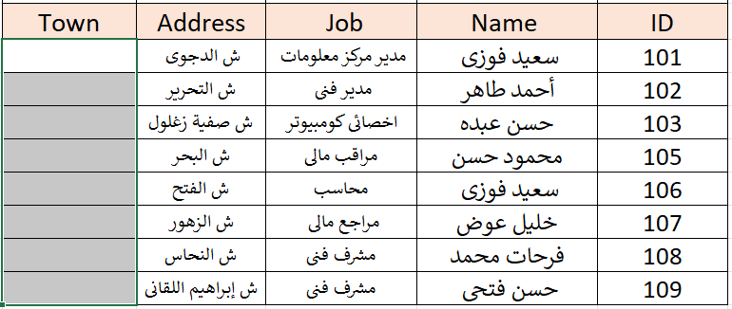
Emp

Slide 33
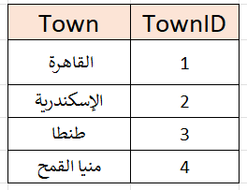
Emp
Towns

Slide 34
Constraints
Emp
Towns
PK
Required
Unique

Slide 35

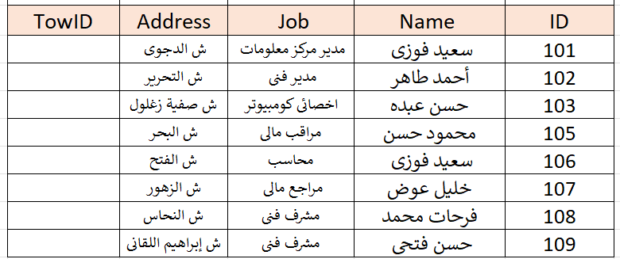
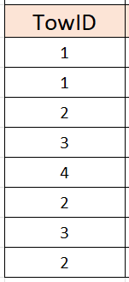
Emp
Towns
FK
PK
INSERT
Constraints
UPDATE
DELETE

Slide 36
Emp
Towns
FK
PK
INSERT
Constraints
UPDATE
DELETE

Slide 37
Emp
Towns

Slide 38
Emp
Towns

Slide 39
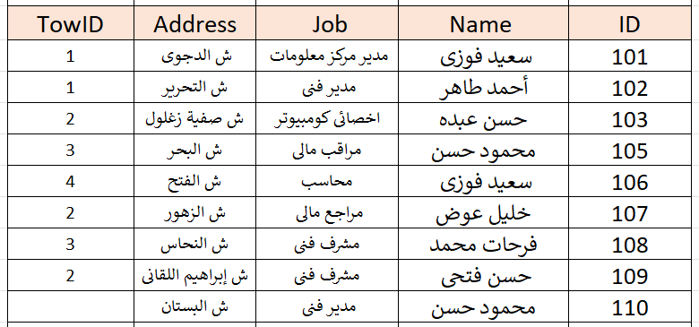
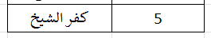
Emp
Towns

Slide 40
Emp
Towns
DELETE
We have no Orphans

Slide 41
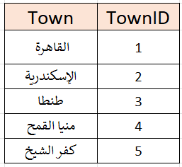
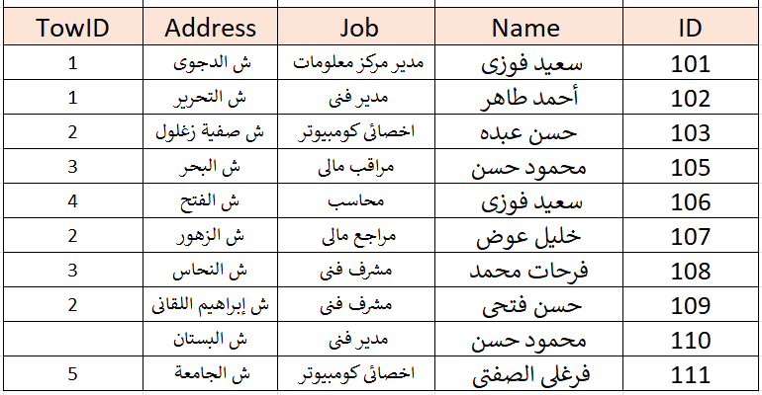

Towns
1
Emp

Slide 42
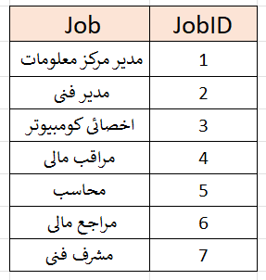
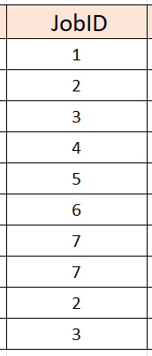
Towns
Jobs
1
1
Emp

Slide 43
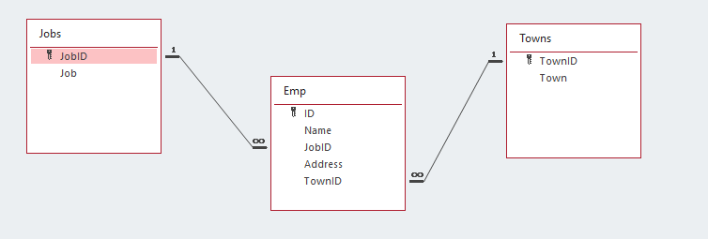

Slide 44


